Slide 1
13 reasons why we love you
<3 NOT

Slide 2
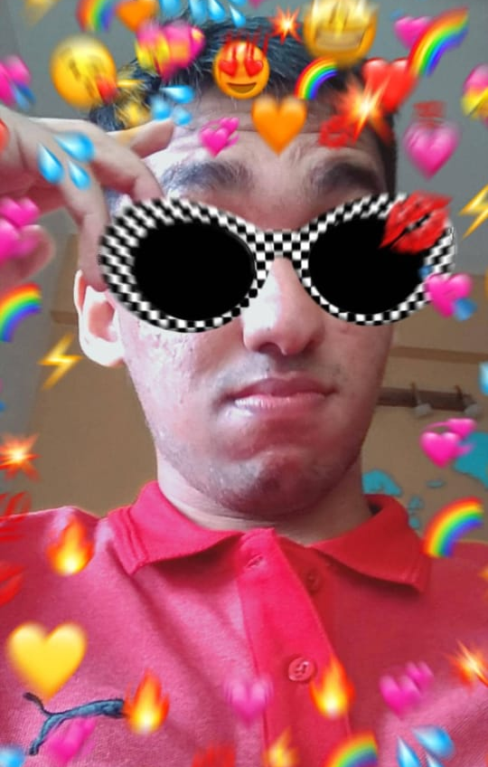
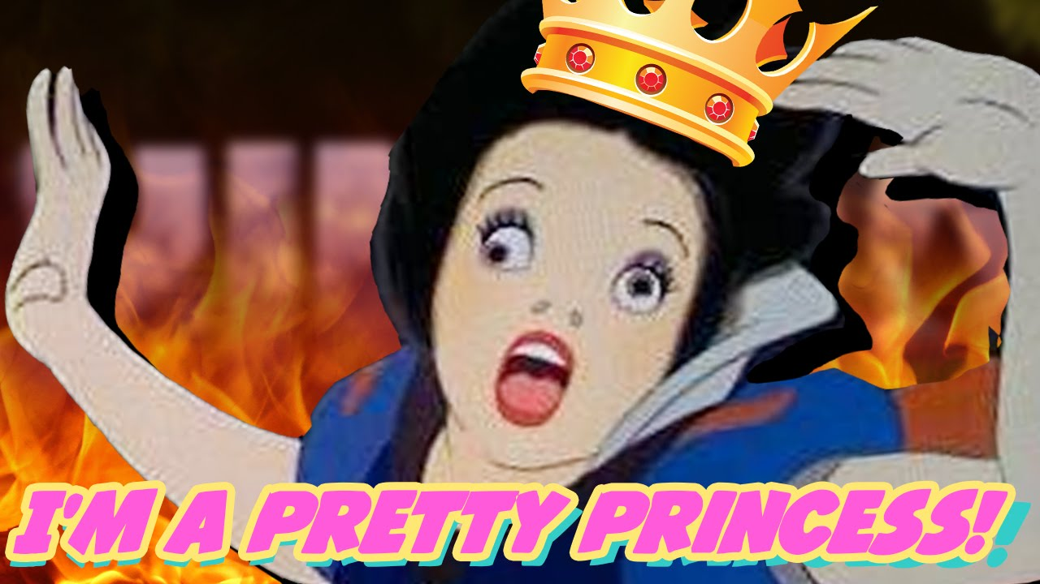
Reason No. 1 : We don’t, only Rohan does
I’m too hot, hot damn!

Slide 3
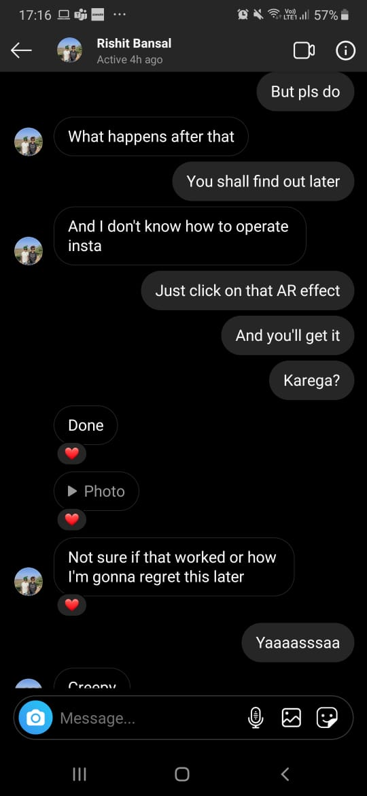
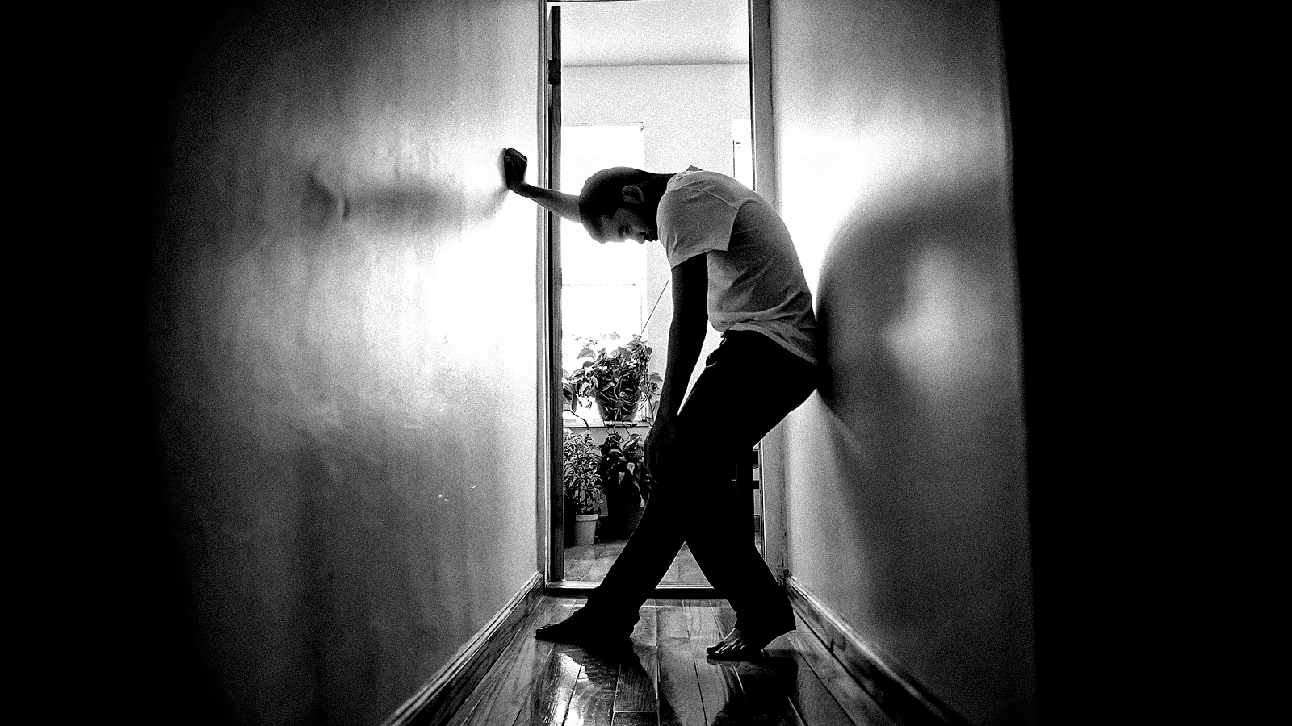
Reason No. 2: You v tech savvy
You are gonna regret this later…

Slide 4
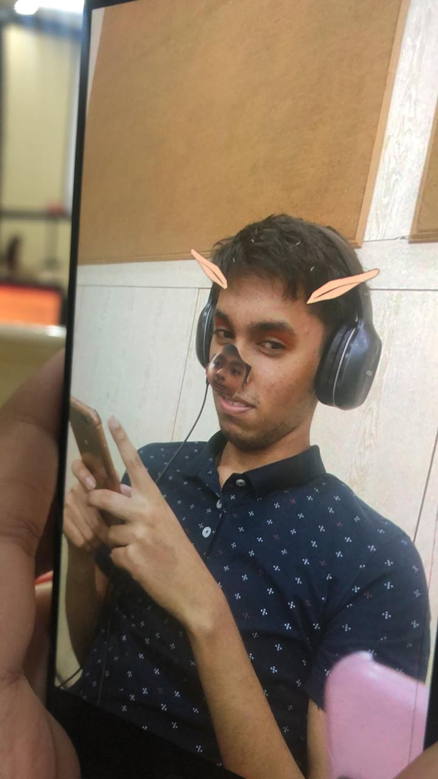
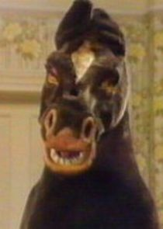
Reason No. 3: sexy nose and ears
Don’t even get me started…

Slide 5
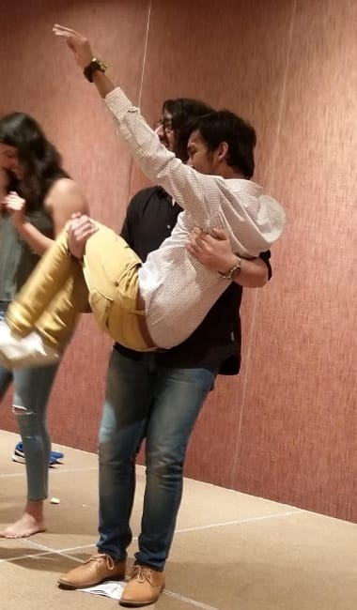
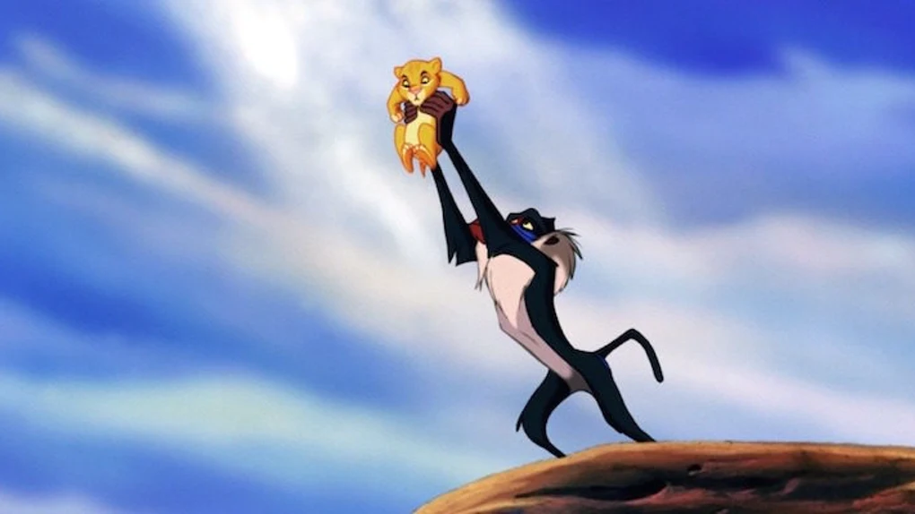
Reason No. 4: absolute princesssss

Slide 6
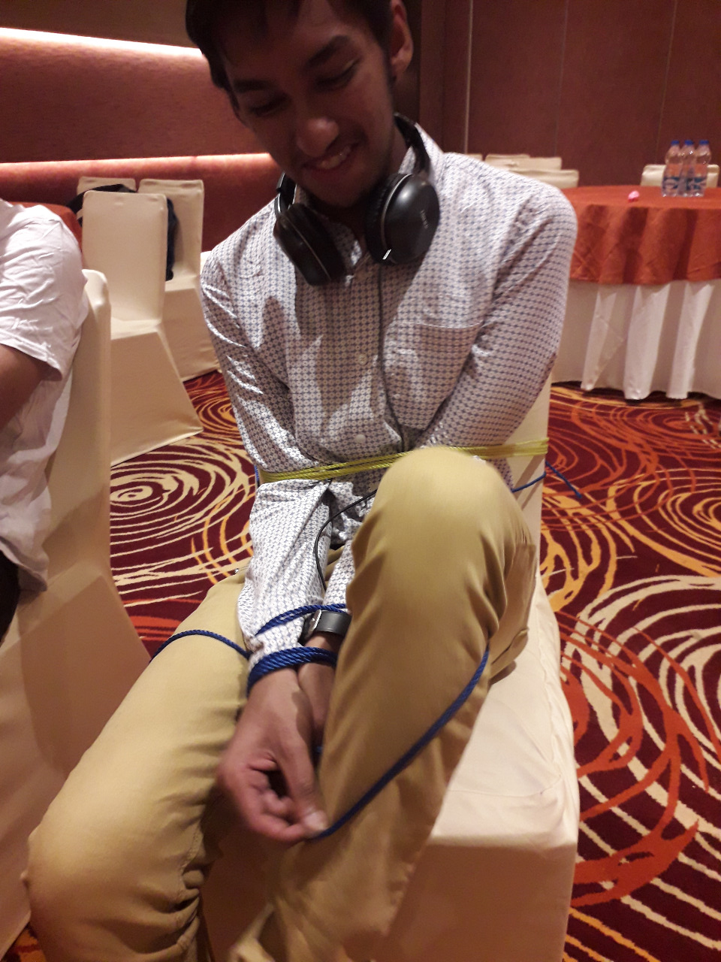
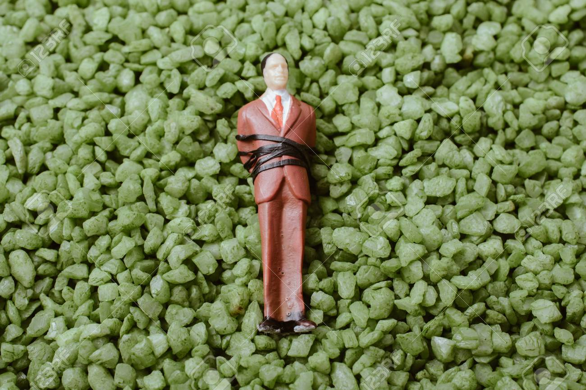
Reason No. 5: Your undying love for
BDSM
R2l2ZSBpdCB0byBtZSBkYWRkeQo=

Slide 7
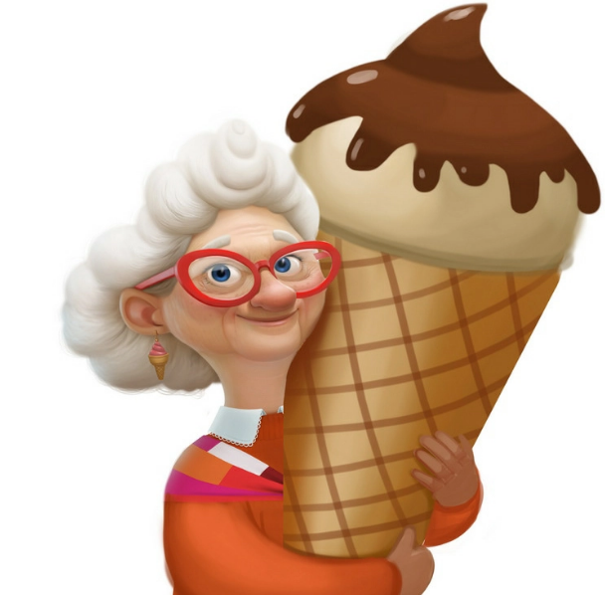
Reason No. 6: <Insert reason here />
Ubuntu sux

Slide 8
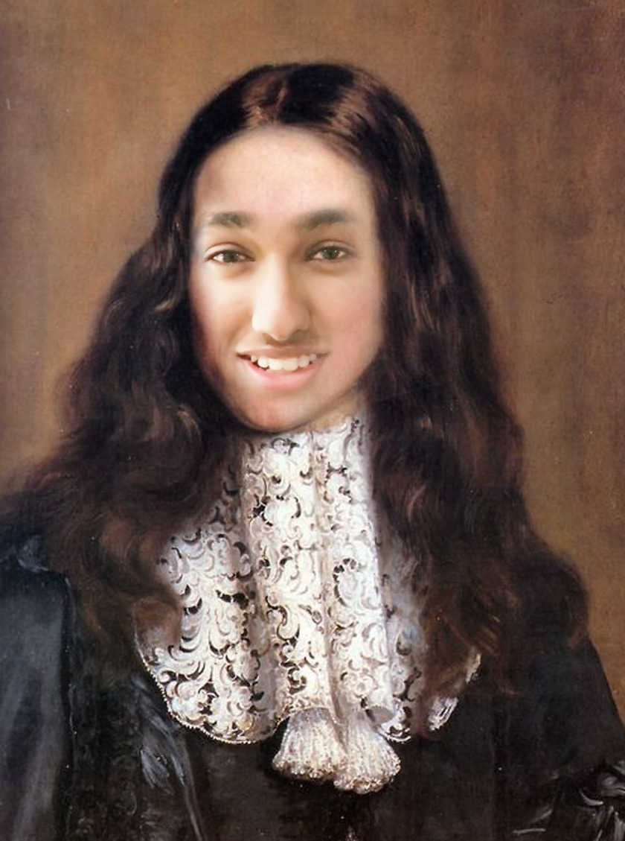
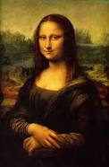
Reason No. 7: Frontend Queeeen
https://userinyerface.com/
Here’s your favorite video of all time
https://rb.gy/enaq3a
<<<<

Slide 9
Reason No. 8: It all started with that smile. How can anyone say no to that ?
RGF2aWQgaXMgZ2F5IAo=
Find easter egg...

Slide 10
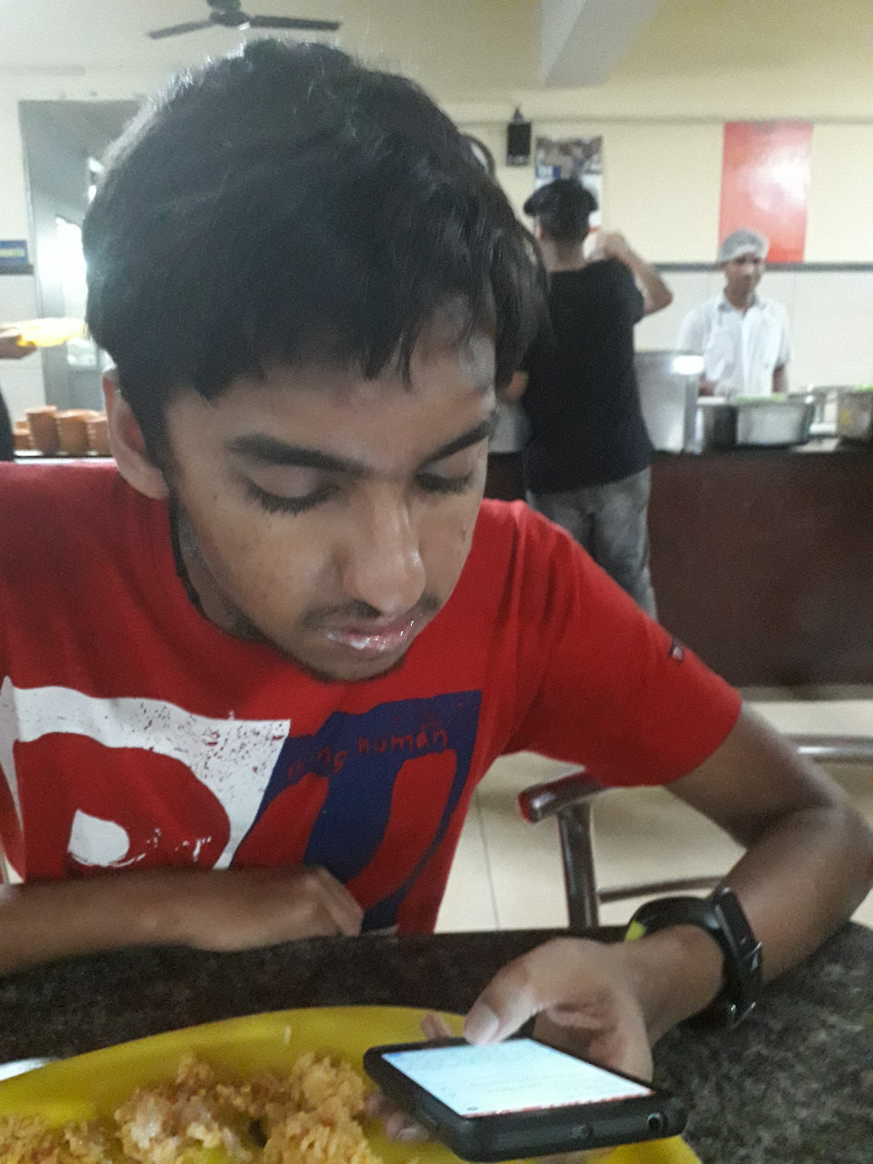
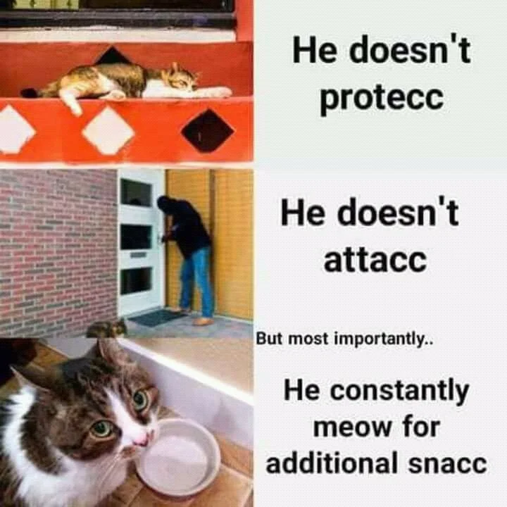
Reason No. 9: You’re a snacc
It’s getting really hard to come up with more
reasons...

Slide 11
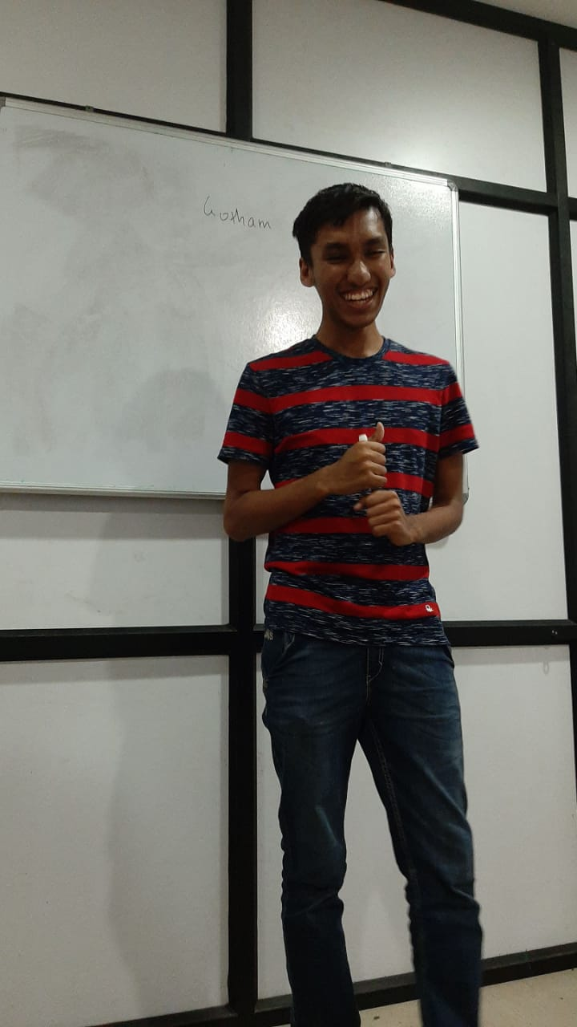
Reason No. 10: It was supposed to be a ‘brief’ explanation

Slide 12
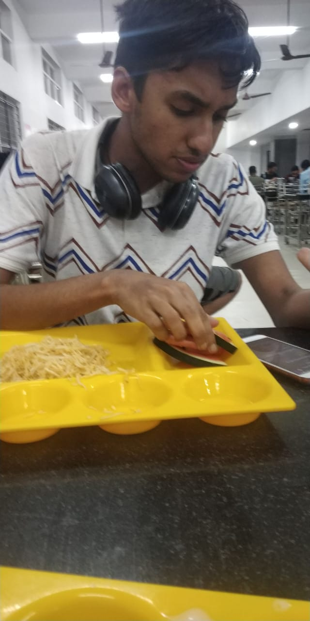
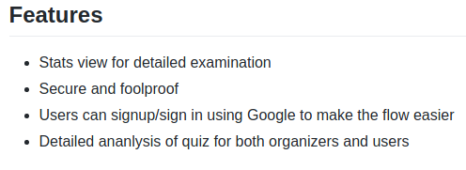
Reason No. 11: Need them tech news
Inside jox
LOOOOOLLLLL

Slide 13
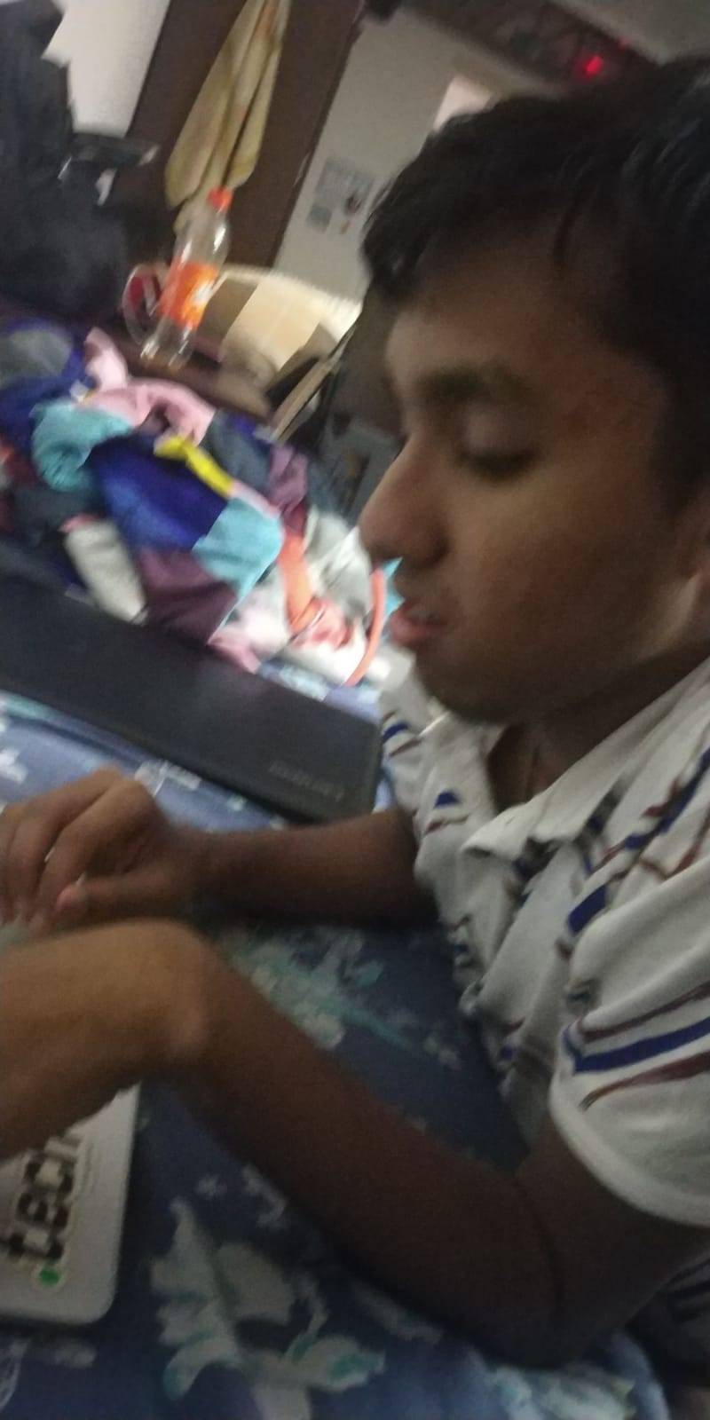
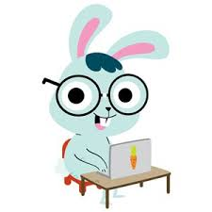
Reason No. 12: Profusanal coder/ bunny
First, I do frontend, then I do Rohan
“Frontend sucks” ~ thebongy * Does frontend all night * ~ also thebongy

Slide 14
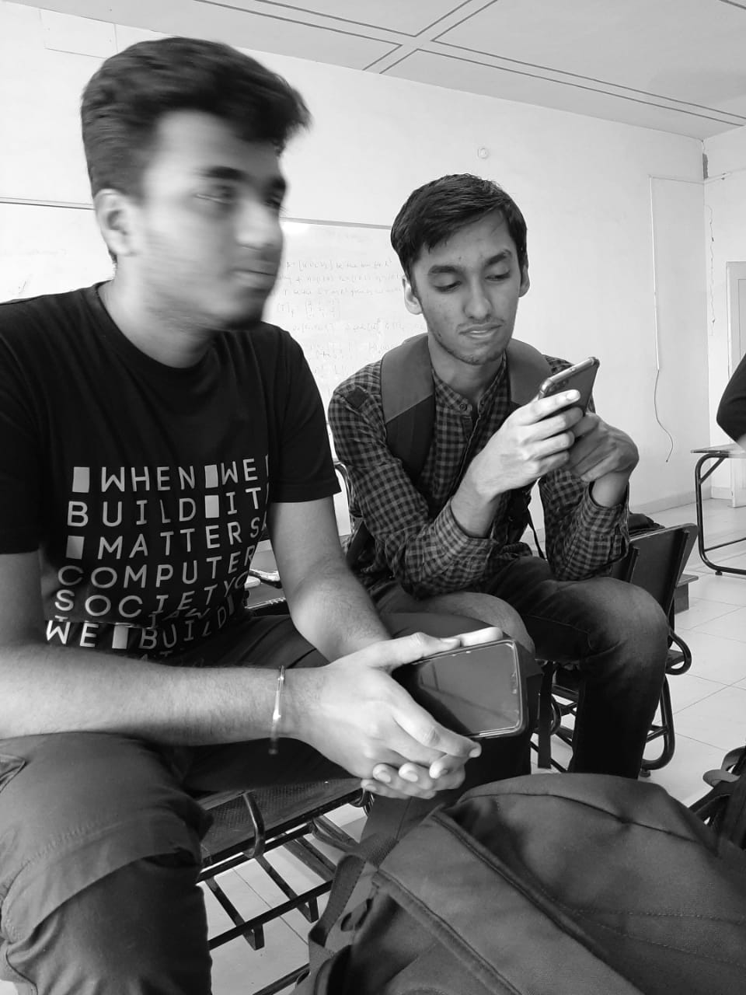
Reason No. 13: idk
Saurav looks too precious to crop out sorry :(
Meeting scheduled after 5 mins. Join the following link:
https://meet.google.com/
Oh btw… Lb1TlTHgeW6lDiUs2VAswQ== or whatever… (AES-CBC, key is in the ppt)

